Slide 1
Python for Science Your new best friend in coding
*
D. T. Welling
University of Texas at Arlington
Department of Physics
*Real snakes are not friends. They are gross and scary.

Slide 2
Python is…
…a multi-paradigm (procedural, object oriented, etc.) general purpose language.
…named after a Flying Circus.
…relatively young: vers. 1.0 in 1994; version 2 in 2000 (IDL->1977; MatLab->1984).
…extremely popular.
…Open source and FREE!
Current versions: 2.7.16 and 3.7.3

Slide 3
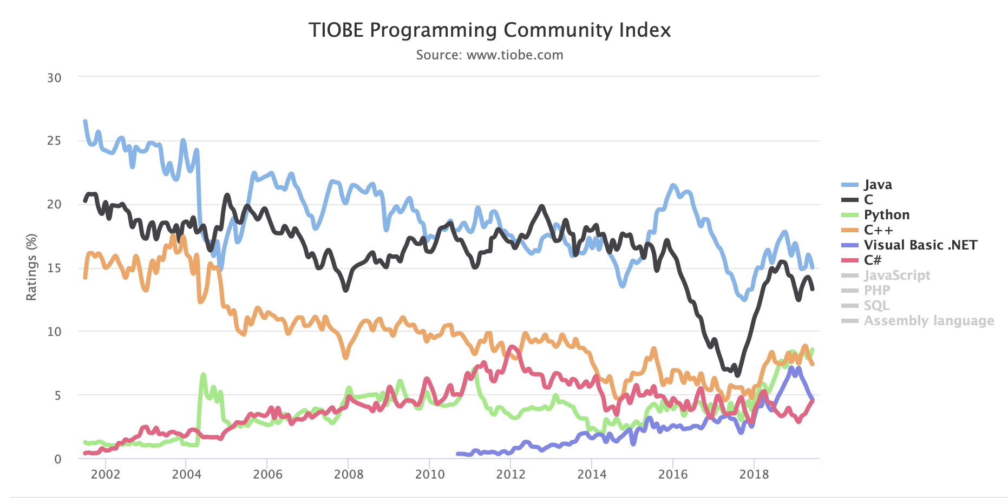
Python is popular- and that’s good!
Online documentation is very good.
Online help is excellent! Always GDS!
There is a growing community of people using it- help is down the hallway.
There is a growing body of space-related Python packages.
Package development moves fast…
Python: #3
MatLab: #18
IDL: >50

Slide 4
Why Python? Why Python for Science?
Powerful, batteries-included scripting rivaling Perl, Bash, etc.
Ubiquitous & cross-platform (Win, *nix, OSX…)
Extensible with C, C++, and FORTRAN
Natural, easy, powerful Object Oriented
Numpy (array algebra), SciPy (common scientific functions), Pandas (data analysis) and Matplotlib (plotting) combine to rival IDL, MatLab.
Combines scripting with numerics, visualization for complete scientific solution.
IT’S FREE
and I’m cheap.

Slide 5
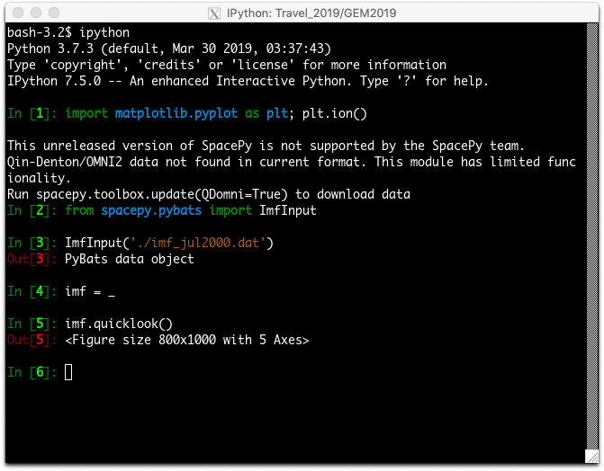
Getting & Using Python
Approach | Notes
Double-click install via Python.org | Can get far more complicated than alternative methods
Anaconda Python distribution | Double-click install; comes with many scientific packages, spyder editor, very straight-forward
Package managers | If you can do the Linux, this is the way to go.

Slide 6
Today’s Tutorial
GOAL: Give you a flavor of Python’s capabilities
Notable data types; multiple assignment
Writing code suites & whitespace delimiting
Importing packages & basic Numpy
Leveraging the object-oriented approach
My resources for learning Python
This tutorial & files: https://github.com/gemcommunity/gem_2019
Syntax tutorials: www-personal.umich.edu/~dwelling/python
Mac install guide: www-personal.umich.edu/~dwelling/python/ notebooks/mac_setup.pdf

